Slide 1
Naïve vs. each group Opened
Cutoff: > 10% any group
Cutoff: > 25% any group

Slide 2
Naïve vs. each group Closed
Cutoff: > 10% any group
Cutoff: > 25% any group

Slide 3
2. Differential motif frequency between KO-WT
Opened in the first group in comparison
e.g. Tfh v.s. Th1 – more open in Tfh
Cutoff: > 10% any group
Cutoff: > 25% any group

Slide 4
2. Differential motif frequency between KO-WT
Opened in the second group in comparison
e.g. Tfh v.s. Th1 – more open in Th1
Cutoff: > 10% any group
Cutoff: > 25% any group

Slide 5
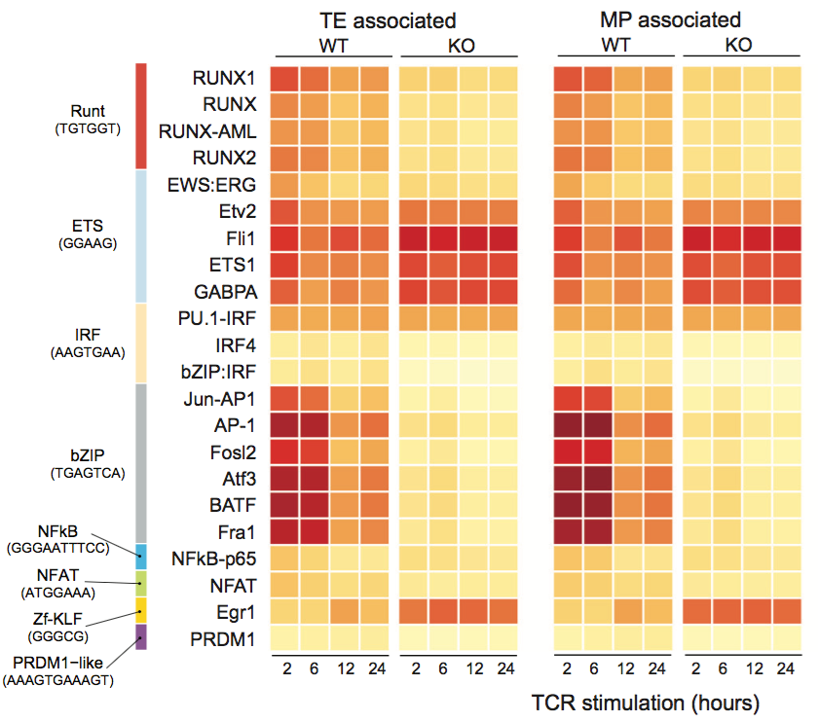

In progress…
3. Motif Enrichment on Tfh and Th1 associated genes or Group IV or Group II genes?
TFs
Tfh⁺ genes
TFs
Th1⁺ genes
Two approaches to try:
Use Tfh and Th1 associated gene set
Use Group IV and II gene set
TFH Associated
TH1 Associated
TFH Associated
TH1 Associated
WT_TFH
WT_TH1
WT_TFH
WT_TH1
PRDM1KO _TFH
DKO_TFH
PRDM1KO _TFH
DKO_TFH
TFs w/ motif
enrichment
Dapeng et al. Immunity 2018
Fig.S4E
(E) Motif enrichment was calculated within the cis-acting regions that were accessible in specific CTL subsets (indicated at top). Heatmaps depict the percentages of the most highly enriched TF motifs within regions that become accessible upon TCR stimulation (frequency in target sequences >15%, on-target frequency/background-frequency ratio ≥1.5, and pval ≤0.05; see methods and Table S2).

